Slide 1
How Spark Streaming works underneath

Slide 2
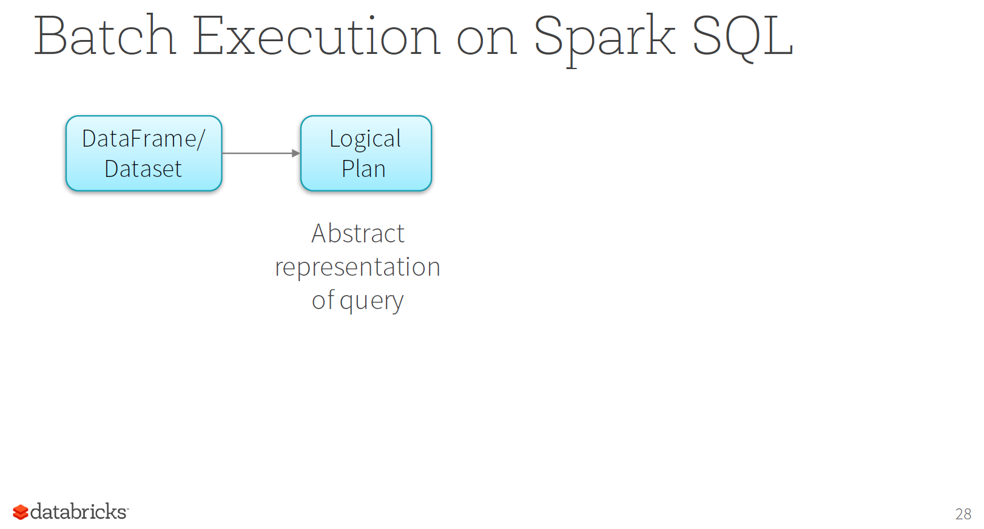

Slide 3
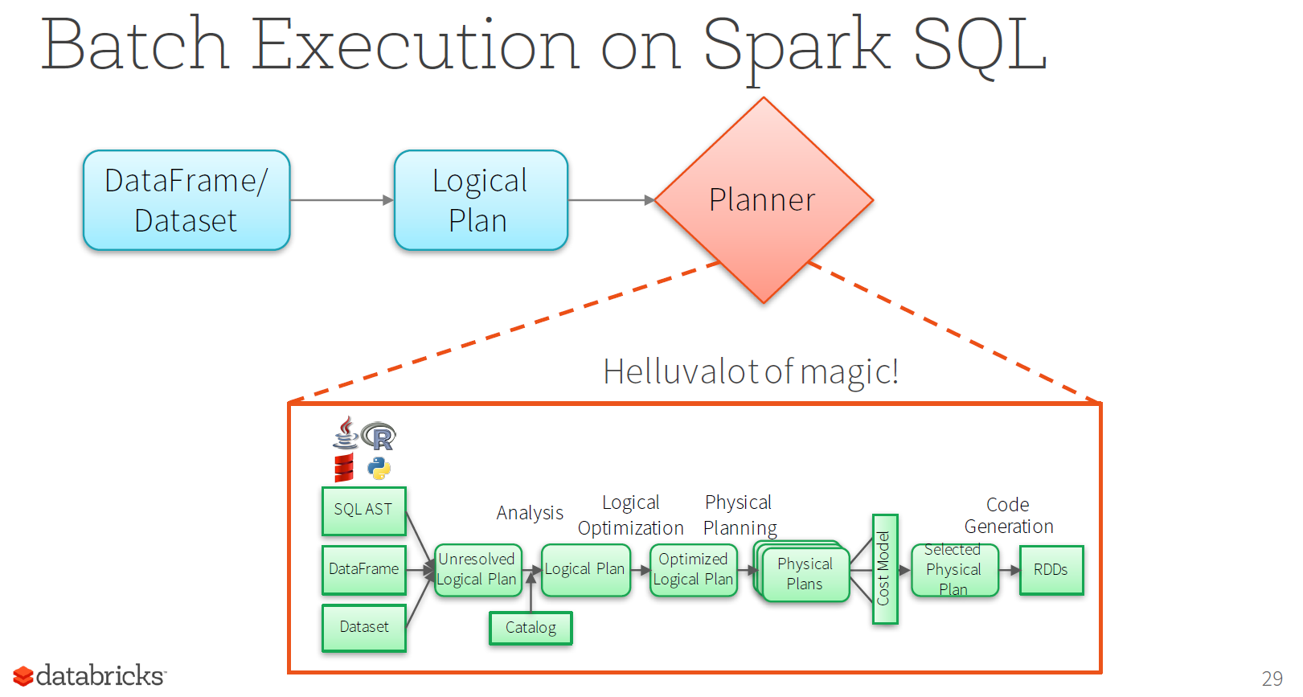

Slide 4
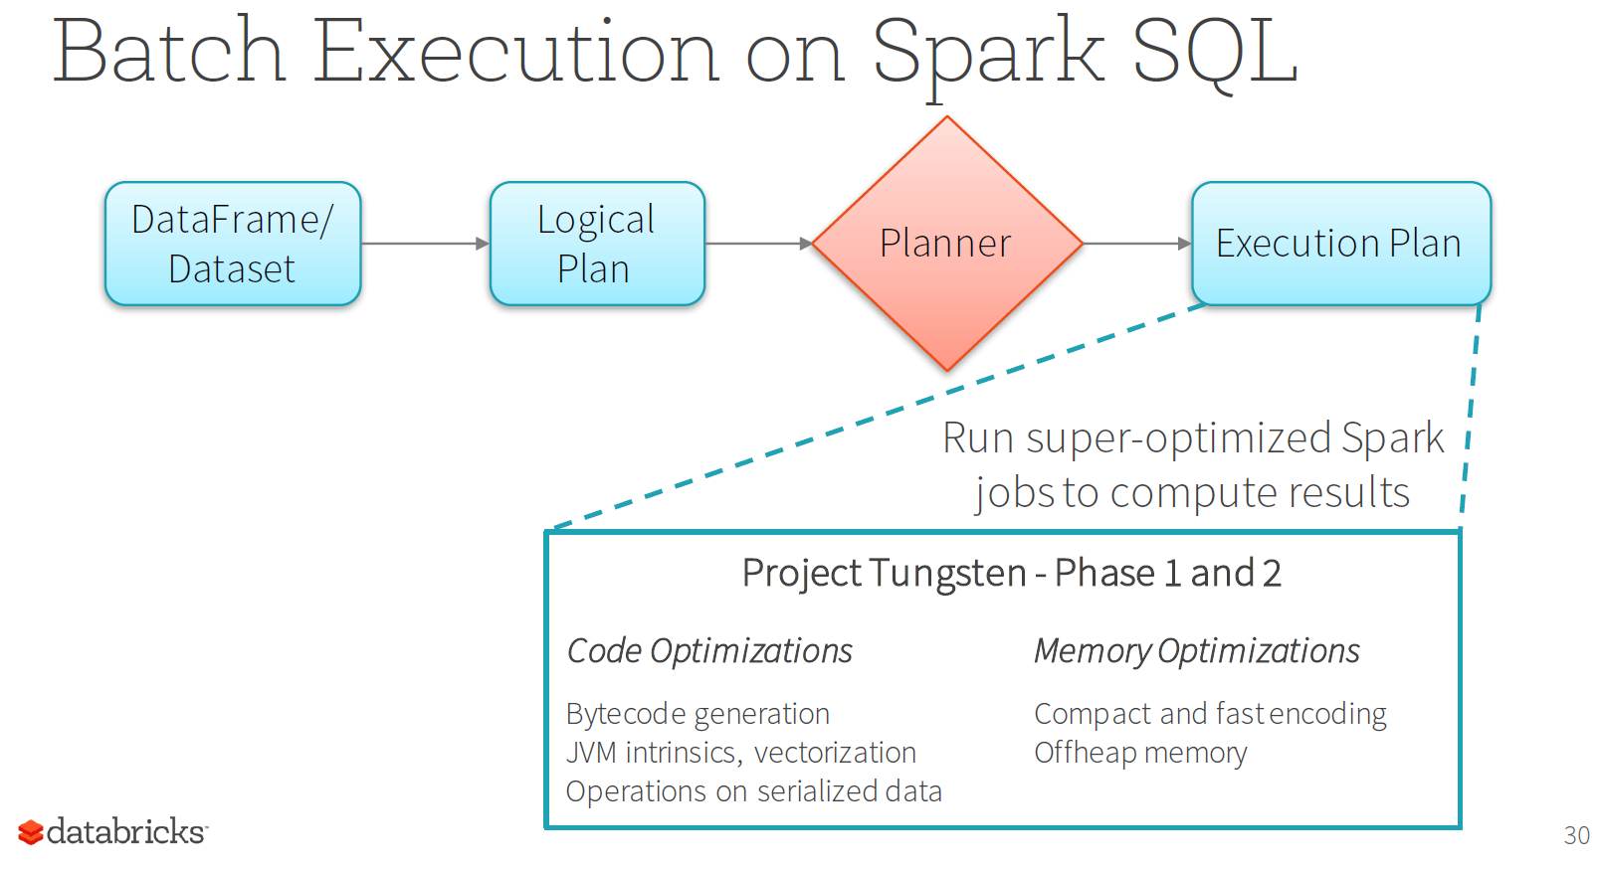

Slide 5
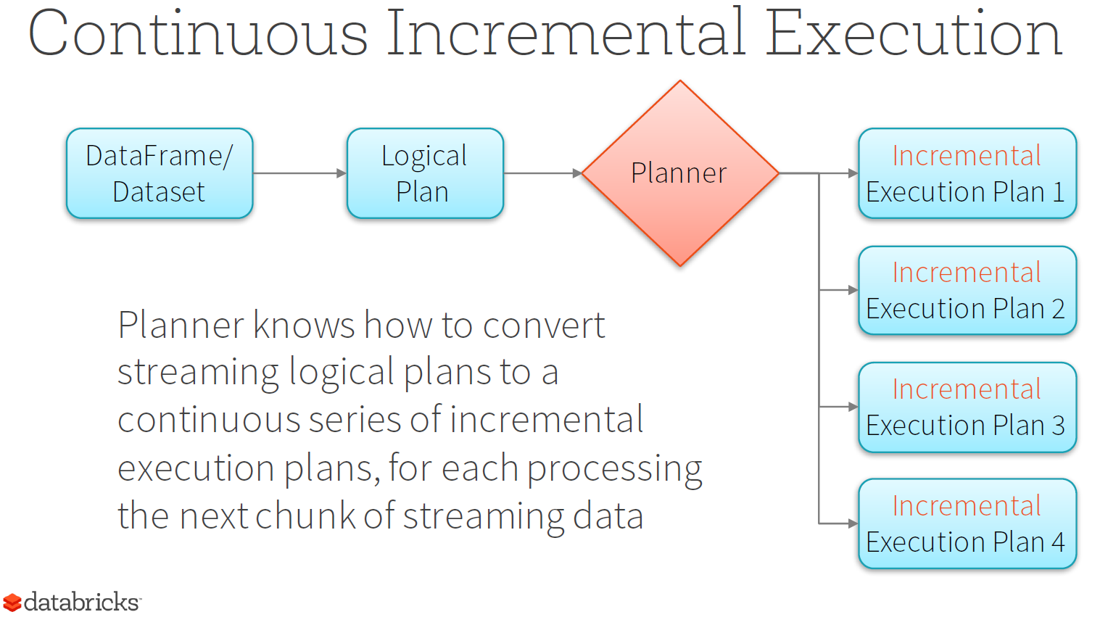

Slide 6
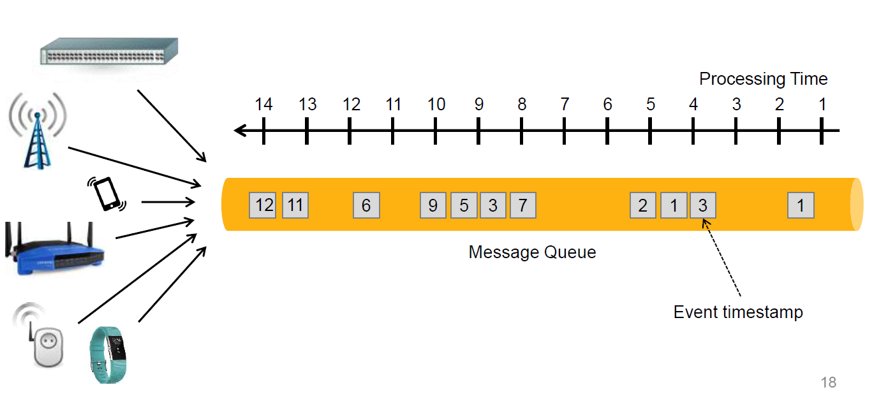
Event time versus Processing Time
The events are pushed onto the back of message a queue.
The events at the front of the message queue are processed first.
Notice in the example above events do not arrive in order.
Structured streaming in spark is able to process data according to the event timestamp order.
Processing in event time order is often critical when looking for important patterns in the data.

Slide 7
Why is event time processing hard?
Data comes in different order from the event time.
For example in the example below data with timestamp 6 does not arrive until processing time 11.
This means we may need to keep some state information for a period of time before moving on.
E.g. if we groupby a time window of 10 mins. We need to make sure there are no more late arriving data items falling into this current 10 mins time window before discarding the group counters for this time window.

Slide 8
Why is event time processing hard?
Here is an example. Consider the following sequence of updates
{value: 1, time: “2017-04-07T00:00:00”}
{value: 2, time: “2017-04-07T01:00:00”}
{value: 10, time: “2017-04-07T02:00:00”}
{value: 5, time: “2017-04-07T01:30:00”}
time is a timestamp
Notice that value 5 above has a later time stamp than value 10
Suppose your application is looking for the following sequence in order to trigger an event:
value: 2, value: 5, value: 10
In order for a streaming system to work for the above case it would need to keep state information:
Keep the value: 10 in its state until it has seen a value: 5
When using Spark’s structured streaming you don’t need to worry about the implementation, you just need to specify what you want and the system will achieve it for you.

